Slide 1
PRISMA
Darko Pranjić

Slide 2
What is Prisma?
Data layer that replaces traditional ORMs/ODMs
Consists of:
Prisma server
Query engine
Prisma client
Realtime event system

Slide 3
Use cases
Working with database
Building GraphQL servers (Apollo ecosystem, GraphQL subscritions, Relay pagination, end-to-end type safety, dataloader)
Building REST APIs (replaces ORM/ODM, database events)
CLIs, Scripts, Serverless Functions & a lot more

Slide 4

Why Prisma?
Type safe database access (Prisma client)
Automatic database migrations
A realtime layer for your database
End-to-end type safety
Data import, export
Soon (access to multiple databases at once, manual migrations )

Slide 5





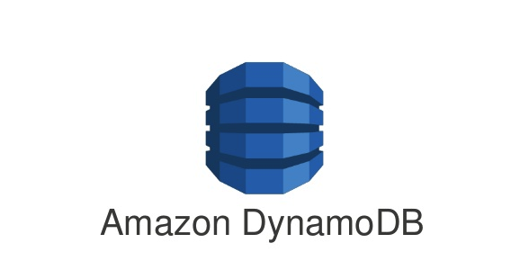


Supported db-s
Supported:
Coming soon:

Slide 6
Supported languages
Prisma client for various languages:
JavaScript
TypeScript
Flow
Go

Slide 7
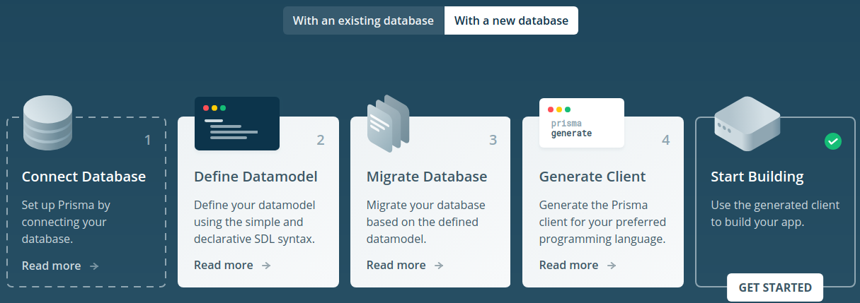
How Prisma works

Slide 8
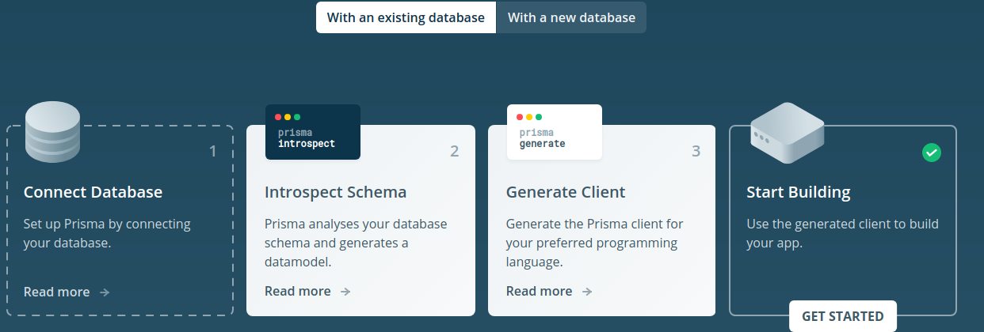
How Prisma works

Slide 9
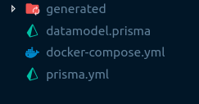
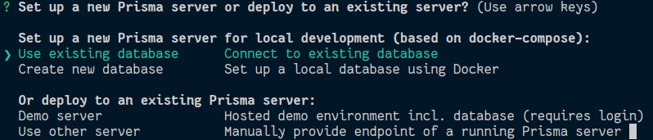
Setting up
Install Prisma npm install -g prisma
Install Docker and Docker compose (to run Prisma locally)
prisma init

Slide 10
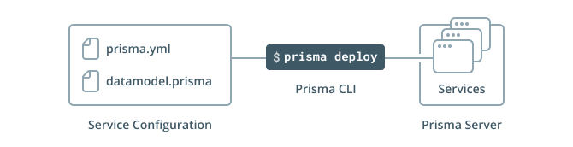
Prisma services
1 Prisma service = 1 GraphQL CRUD database mapping
Configuration using:
Datamodel: models which Prisma uses to generate the GraphQL API.
prisma.yml: service's endpoint, the service secret, the path to the datamodel file, … (root configuration file for Prisma)

Slide 11
Datamodel
Creating datamodel (manually, derived from existing database schema)
Writen in “.prisma”, “.gql”, “.graphql” files, uses GraphQL SDL syntax.
Major roles:
Define the underlying database schema
Foundation for the auto-generated CRUD and realtime operations of your Prisma API.

Slide 12
Datamodel - building blocks
type Post { id: ID! @unique createdAt: DateTime! published: Boolean! @default(value: "false") title: String! author: User! } type User { id: ID! @unique email: String @unique name: String! posts: [Post!]! }
Types
Directives
Relations

Slide 13
prisma.yml
datamodel: - database/types.prisma
- database/enums.prisma endpoint: http://localhost:4466/myservice/dev secret: ${env:PRISMA_SECRET} databaseType: relational / document
generate: - generator: javascript-client output: ./generated/prisma-client - generator: graphql-schema output: ./generated/ hooks: post-deploy: - prisma generate seed: import: database/seed.graphql custom: serverlessEndpoint: https://bcdeaxokbj.execute-api.eu-west-1.amazonaws.com/dev
Type definitions
Prisma server
Service name
Stage
Environment variable

Slide 14
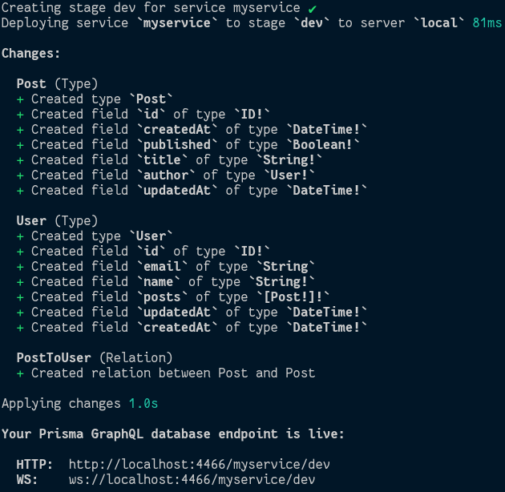
Deploy

Slide 15
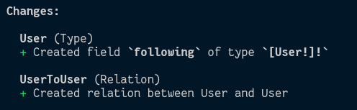
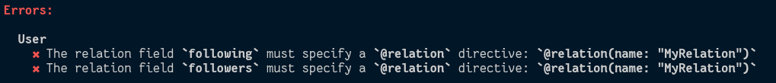
Migrations
Add new relation between ‘Users’ - field following
Add new relation between ‘Users’ - field followers
type User { id: ID! @unique email: String @unique name: String! posts: [Post!]! following: [User!]! }
type User { id: ID! @unique email: String @unique name: String! posts: [Post!]! following: [User!]! followers: [User!]! }

Slide 16
Prisma client
generate fields:
generator - programming language
output - Prisma client store folder
generates:
typescript-client
javascript-client
flow-client
go-client
graphql-schema

Slide 17

Questions before example?

Slide 18
Example: building server

Slide 19
Questions

